Slide 1
Application of Redis in IOT Edge Devices
By Glenn Edgar
LaCima Ranch

Slide 2
Overview of Presentation
We will talk about our irrigation system.
We will talk about are evolution in the use of Redis.
We will talk about the need to manage the IOT system much in the same manner as an online business.
Concept of the Nano Data Center.
We will talk about the need for a Graphical Data Base.
We will talk about the need to automatically generate the Redis keys and data structures.
We will talk about a new IOT to Cloud Communication.
Thru the use of synchronizing the IOT Redis Data Base and the Cloud Redis Data Base.

Slide 3
Brief Description of System
Original System
System Architecture
Use of Sprinkler Wire as a Field Networking System
Layout of PLC
PLC Deployed in the Field
Rough Environmental Conditions
New System Changed Operations

Slide 4
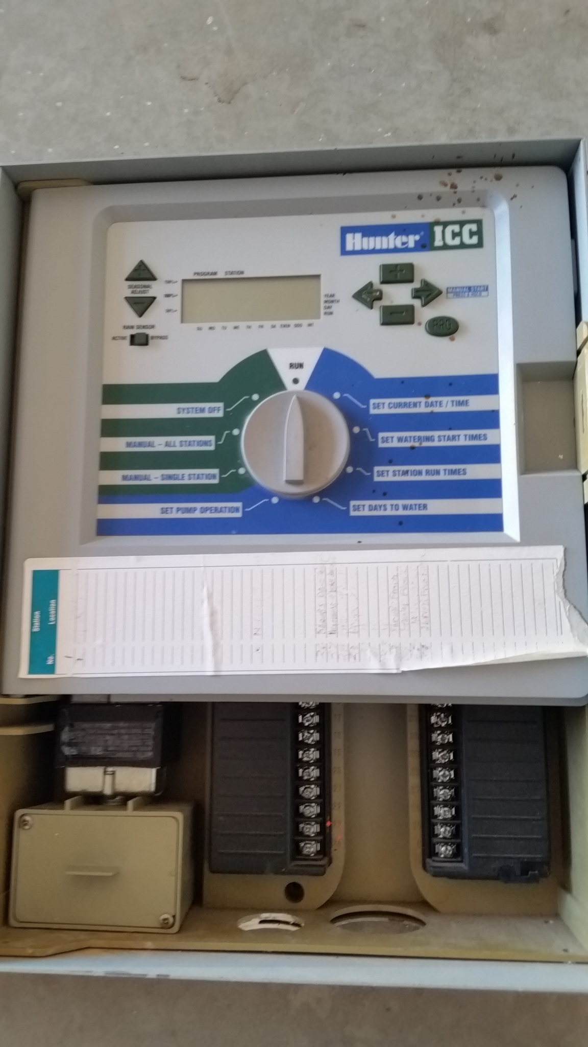
Our Original System
A Hunter 48 station irrigation controller.
The system was set up by clicking dials in a most painful manner.
The system supported only two schedules and was very difficult to change and configure.
At the time this unit would cost around $800 dollars.

Slide 5
Our New System Architecture
Cloud Controller
Individual
Sites
Individual
Sites
Individual
Sites
Individual
Sites
Individual
Sites

Slide 6
Break out For Site Or Edge Device
1 or more
Raspberry PI
Controllers
See Note
Sprinkler Wire
Distributes Power
And RS485 Communication
Satellite 1
PLC Controller
Satellite 2
PLC Controller
Satellite 3
PLC Controller
Satellite 4
PLC Controller
Note: Till the 2015 time frame the controller was a Beagle Bone Black

Slide 7
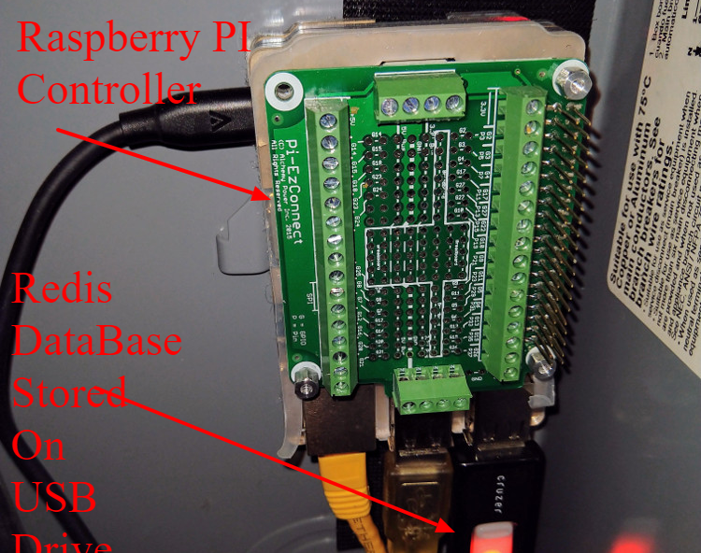
Redis DataBase is Stored on External USB Drive
The reasons for the use of an external usb drive to store the redis database is as follows.
Power Failures will happen. Putting Redis on a external USB drive insures that the Linux File System on the SD Card has few writes during operation. This lowers the risk of file corruption during power failures.
By having the Redis Database on an extern USB Drive makes replicating both the SD card and Redis Database easier.

Slide 8
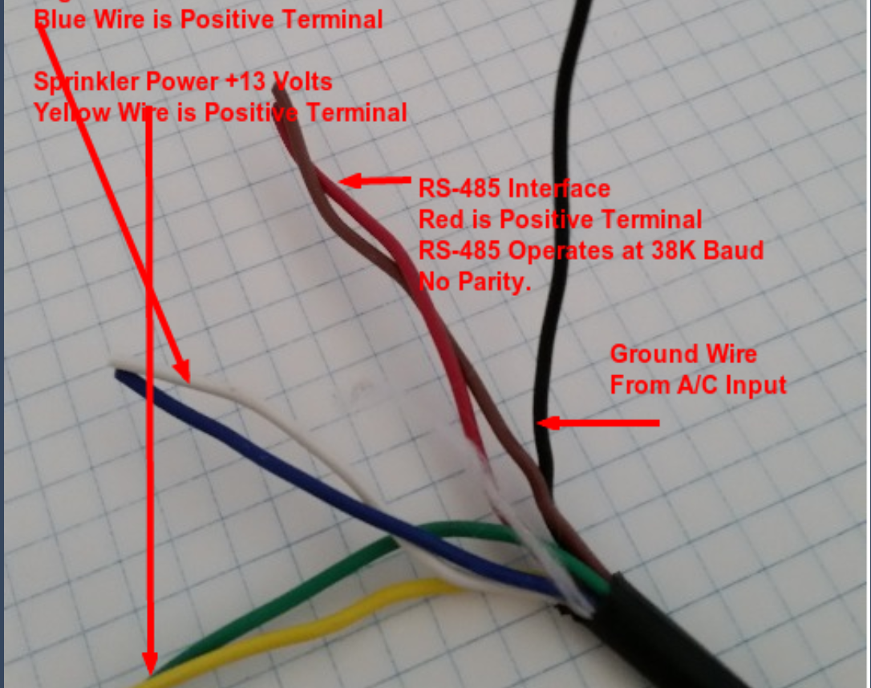
Existing Sprinkler Wire was used as Networking Cable
7 Strand 18 gauge sprinkler wire.
Blue/White 24 Volt DC to power PLC’s.
Yellow/Green 15 Volt DC to power sprinkler solenoid valves.
Red/Orange/Black used to support a 38.8 kbits RS485 communication link.

Slide 9
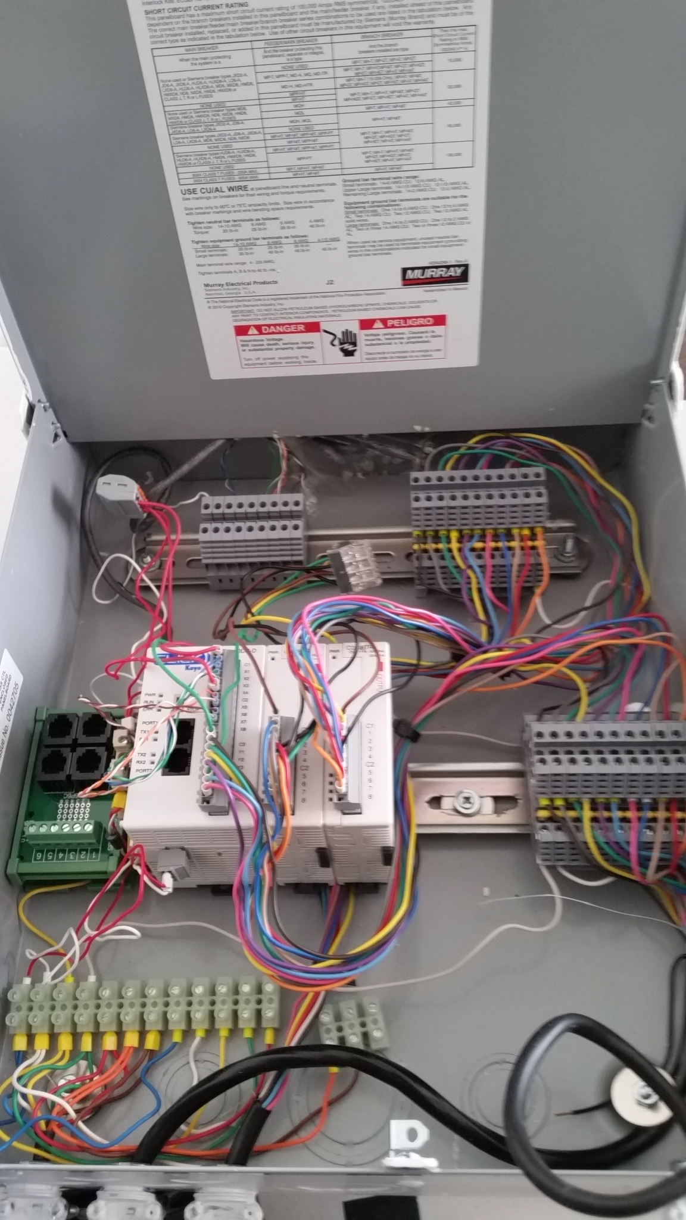
Inside of PLC Case
PLC and Expansion Unit – Automation Direct Click Line. ( Free Programming Software )
SCADA terminal blocks are used to connect wires.
There are 22 sprinkler connections.
8 Digital Inputs which four can be used flow meter interfaces.
System Cost is less than $300.
Components are UL and FCC certified.

Slide 10
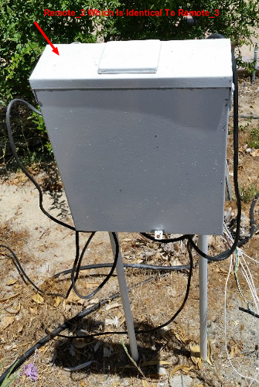
PLC Deployed in the field.
The picture shows the PLC unit deployed to the field.
Electrical conduit pipe is pounded in the ground and the PLC unit attaches to the conduit.

Slide 11
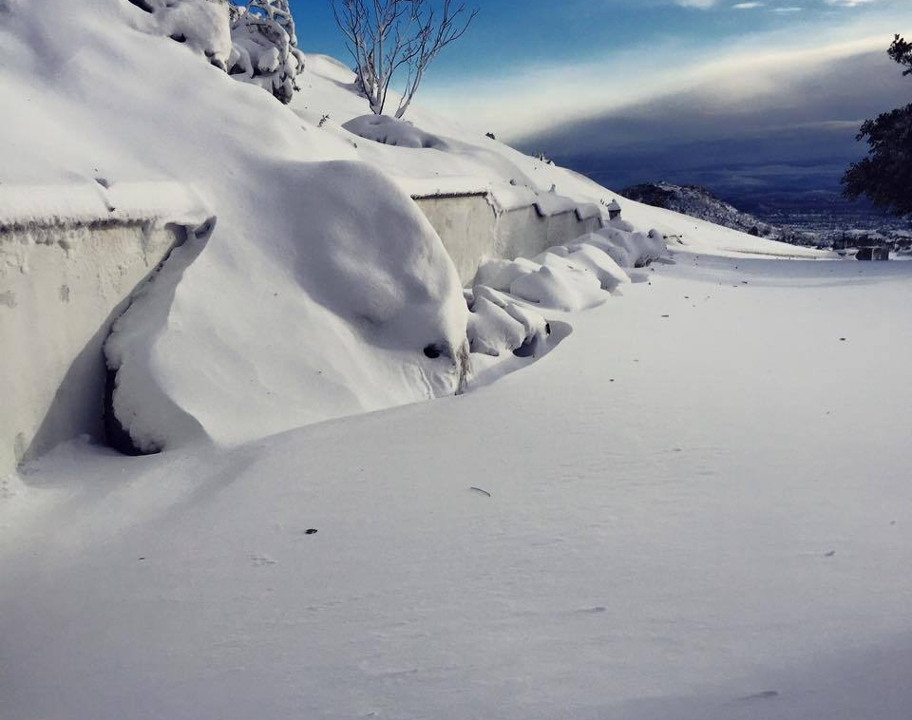
Some PLC Units have been deployed for 5 years.
Our Avocado Grove is a 2400 feet.
Several years ago, we had 24 inches of snow over night.
Outdoor equipment survived without problem.

Slide 12
Some benefits to new system
Web Based Flexible Irrigation Scheduling.
Cloud Interface Allows Remote Operations.
Weather Station integration which allows irrigation times set to water evaporative loss.
Current Sensor to monitor irrigation solenoid performance.
No Current open wires.
Too much current a shorted condition.
Flow Meter to detect leaks and clogged emitters.
Some examples are showed on the next page.
Well Pressure and Pump Current logging will be added shortly.

Slide 13
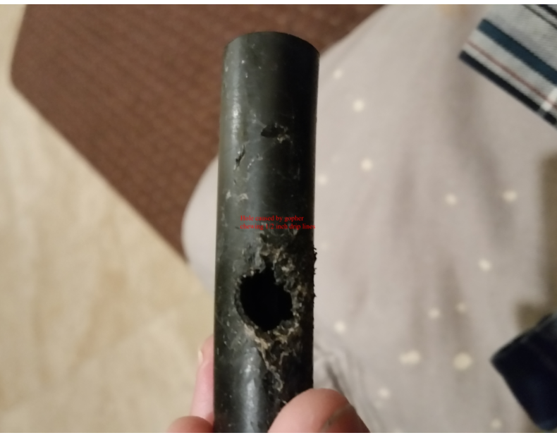
A leak that took 3 weeks to find
The system detected a 3 GPM excess flow. Field Inspections did not find the leak for three weeks.
On the third week, after an exhaustive search, the leak was found. The hole was pointed downward and flowed into a hole. The leak watermarks were not shown in the field.

Slide 14
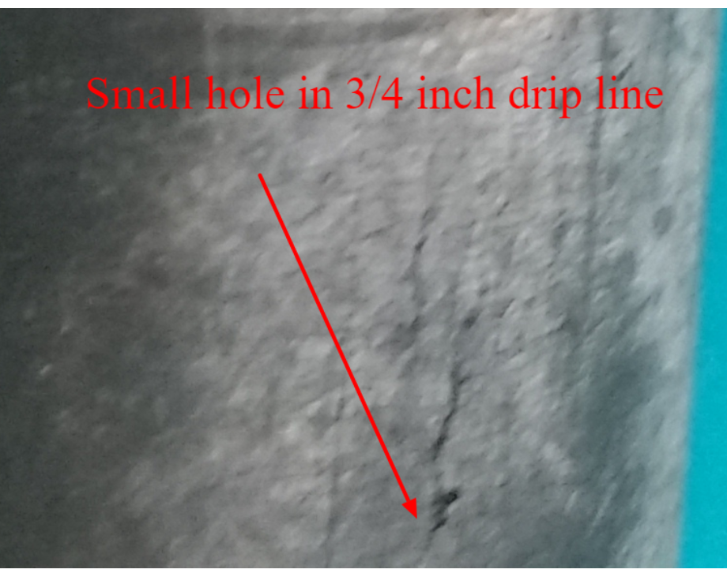
Another Leak not Detectable by manual means.
This line has a small crack which generated a .5 gallon/minute excessive flow. The System detected the excess flow.
The lines had to be checked carefully to find this leak.

Slide 15
New System Transformed Operation
Instead of looking for problems, the system directed action to systems which have failed.
This is important as it takes about 2.5 hours to manually check the grove. At $22.50/hour and once a week, the total cost for manual checking is $2925.00 /year. This is about 3 times the cost of my system.

Slide 16
Needed to Replace Mongoose Web Server with Python Flask Web Server. (Time Period 2014)
My backgound is embedded system design.
First starting out in assembly and DSP programming
Moving to C and RTOS Programming.
Moving Embedded Linux and Set Top Box Programming.
And finally introducing Lua, SQLITE, the Mongoose Web Server and jQuery into the mix.
I used the Lua/SQLITE/Mongoose Web Server as my first basis for irrigation control.
The implementation was a single Linux process on a Beagle Bone Black.

Slide 17
Needed to Replace Mongoose Web Server with Python Flask Web Server. (Time Period 2014)
The Mongoose Web Server Needed To Be Replaced
Original
System
Monolithic
Linux Process
Both Processes Need to Communicate
With Each Other
Irrigation Control
Process
Flask Web Server

Slide 18

Redis Provided The Multiprocess Communication
Now instead of single process, there are two processes. The architecture had to change.
I picked up a copy of the Redis cookbook and found an example of a job queue.
Redis and Flask Web Server were incorporated on my irrigation system using a Beagle Bone Black.

Slide 19
With Redis in the System The Irrigation Controller Software Began to Change.
With Redis as a central hub, the monolithic irrigation program transformed into:
Lua code was replaced with python code as the need for embedding code went away.
Modular python processes implementing a single function.
Communication through the Redis Data Base.
A python process communicates strictly to the redis data base with the exception of the I/O controller.
Irrigation
Controller
Time of Day
Scheduling
Program
Flask
Web
Server
Calculate
Evaporative
Loss
Redis Database
Various
System
Monitoring
Processes
I/O Controller

Slide 20

The amount of Logging and Managing the Logging Became Complex.
I read the book, “ART of Monitoring” by James Turnbull and came to the following conclusions.
Redis could do most of the non web functions listed in the book, quite well considering the size of the target.
The IOT gateways should be managed much in the same way one would manage the infrastructure of an online business.
I labeled this environment a “nano data center”.
Do not manage the system as an embedded device but manage the device as a data center.

Slide 21
Overview of Redis Database
Redis Database
The Redis Database consists of three different types of enities:
Control Structures
Logs or Streams
Configuration Data
Configuration Data consists of user defined irrigation schedules, system definition of items such as
System Items such as master valves
User Defined Irrigation Schedules
User Defined Limits
Configuration data is loaded to redis from files and stored back to files when changed
If the Redis Data Base is lost then the system will continue to operate. Within a week most of the log streams will have enough information to be fully functional.
Configuration
Files
Configuration
Data
Redis Control
Structures
Job Queues
Rpc Servers
Redis Logs
Or Streams

Slide 22
Introduction of Graphical DB into The System
Adding functions to the system became increasingly difficult. The problem arises from the need to coordinate information between processes both in the gateway device and the cloud.
The above information could be stored in a nested document structure or the data could be stored in a graphical database. The graphical database has a query language and the nested document does not have a query language.
The query language of the graphical database allows information to be found with a just a few terms.
I found out that Redis was capable of supporting a graphical database.

Slide 23
Graphical Database on Redis
Redis has a graph database module. (The features are excellent with the exception, that pieces of graphs need to be moved from one Redis implementation to another Redis implementation. This feature is extremely useful in IOT gateway to IOT cloud integration.)
Unfortunately, Redis Graph module does not run on the raspberry pi.
Before, the Redis graph module was released, I developed a not for prime time graphical data base with a query language. I will not go into the description of the graphical data base in the presentation.

Slide 24
As An Aside Graphical Data Bases Are Appearing In Conventional SCADA Systems.
Redis Cluster is used in a Chinese Electric Utility Company as described in the following paper.
http://dpi-proceedings.com/index.php/dtcse/article/view/5316/4939
In this paper the key Design for the Redis Database is governed by IEC61970 standard.
A description of the of the IEC61970 can be seen at the following link.
http://citeseerx.ist.psu.edu/viewdoc/download?doi=10.1.1.112.4648&rep=rep1&type=pdf
RDF is used to describe system model and XML is used to describe node properties.
The IEC61970 model is a natural model for a graphical Database.

Slide 25
Nature of Graph – SNMP on Steriods
Cloud Graph
Edge Device Graph
Edge Device Graph is a Subgraph of the Cloud Graph

Slide 26
System Graph is Constructed at Startup
System
Code scripts construct the system graph upon startup.
The graph is limited to a tree structure graph.
The construction is done in a modular manner.
The code is under configuration control and changes to the system graph can be tracked.
As a side note, with Graphana Dashboards, some organizations are using python scripts to setup dash boards.
Site
Controllers
Controller A
Controller B
IO_Control
Applications
Attached Processes
To Controller A

Slide 27
The Graph Structure for around the weather stations
Site Node
Note Relationships
And properties Not Shown
Applications Node
The weather station application will first query for the Weather Station Node, such that the path goes through the site node with the site property in the “site.json” file.
Once the weather station node is found, then the two stream data structures are found and constructed.
Next the weather station nodes are found and packages constructed for each weather station.
Computing the ETO and Rainfall is a matter of executing all the weather station sites and combining the values in a manner specified in node properties.
Weather Station Node
Data Package Node
WS_Station Relationship
Stream for Daily
Rain Values
Stream for
Daily ETO
Values
Individual Weather Stations

Slide 28
There are two sources of Redis Data
The first source is system level data structures. These data structures are added to the graph.
These data structures are fixed by the current application structure of the system and will not change unless a software upgrade is done.
These structures include:
Hash Tables
Streams
Job Queues
RPC Queues
The definition of these structures are embedded into the graph.
Applications can use python support packages to generate classes to access these structures.
The user does not manage the key names.

Slide 29
Second Source Of Redis Data
The second source of Redis Data is from user generated data through web site interactions. This data includes:
Irrigation Schedules
System action such as:
Filter Cleaning
Irrigation Valve Check
This application data generates unique streams depending upon user configuration.
Upon startup the system has a python script which will generate an application graph for this data.
Like the other type of data the access classes are automatically generated.

Slide 30
The Redis Graph Changes The Nature of IOT to Cloud Communication
Consider the following, eto, ( evaporative loss), calculation process.
The ETO process receives data from the graph about weather station data such as url’s and access tokens.
The ETO process will calculate the daily ETO and update the moisture deficient table and the ETO History Stream.
The Irrigation Controller will use the moisture deficient table to determine irrigation run lengths.
The Web server access both data structures to display to the user and to manually adjust the moisture deficient table if necessary.
Graph Data
Irrigation Controller
Moisture
Deficient
Hash
Table
Process to calculate ETO
ETO History Stream
Web Server

Slide 31
Move ETO Data To The Cloud
A case can be made that the ETO calculation should be done at the cloud as each weather station could have different url’s and access tokens. The processing would look like this.
Cloud Graph Data
Moisture
Deficient
Hash
Table
Synchronization
Mechanism to keep cloud and edge device data bases loosely synchronized
Irrigation Controller
Moisture
Deficient
Hash
Table
Process to calculate ETO
ETO History Stream
ETO History Stream
Web Server

Slide 32
Method Of Synchronication
Update
Changes
From Cloud
AMQP Channel From Cloud to IOT Device
Send
Changes
To IOT
Redis
Cloud
DataBase
Redis
IOT
Database
Send
Changes
To Cloud
AMQP Channel From IOT Device to Cloud
Update
Changes
From IOT

Slide 33
Synchronization of the Edge and Cloud Data Bases
The synchronization of the edge and cloud databases could be done with:
There are 2 AMQP connections per device.
a handful of primitive commands for updating hash tables, streams, job queues and rpc queues in an atomic manner. Perhaps less than 30 commands.
All redis accesses are bundled in centralized routines and as a result the transport mechanism would also be centralized in small amount of code.
The synchronization of the databases would be transparent to the user.
This compares to a conventional MQTT or a conventional AMQP connection, where there are messages for each instance of data. There could be hundreds of unique messages.

Slide 34
Conclusion
We at Lacima Ranch were strictly embedded developers.
We had no vested interest in promoting in Redis.
How over 4 years of operation, we have shown that Redis is essential to the operation of our system, both at the IOT level and at the Cloud level.
But we are lacking one thing.

Slide 35
Conclusions Continued
We at Lacima Ranch have be operating in isolation for over 4 years.
We need to fold our work into an open source IOT effort.
We do not have the resources to take this work much further than satisfying our own needs.
We will help individuals and organizations in establishing this open source effort.

Slide 36
Thank You

